Slide 1

Netflix Original Films:
An IMDB Score Analysis(Team 1)
Bhumika Bista
Sujana Joshi
Dipti K C
09 June, 2025

Slide 2

Introduction and Goals
Dataset Overview
Our Objectives
Information on Netflix Original Films, including Title, Genre, IMDB Score, Premiere Date, Runtime, and Language.
Understand, clean, and analyze data. Identify patterns and gain insights through visuals.
1

Slide 3

Data Profiling
Dataset Structure
Examined total rows and columns using df.shape().
Data Types and Values
Checked data types and non-null values with df.info().
Sample Data
Viewed initial rows using df.head() for a quick overview.
Statistical Summary
Obtained statistical insights with df.describe().
2

Slide 4





Data Quality and Cleaning
Missing Values
Identified missing values, for example, in Language or Runtime.
Data Imputation
Filled numerical missing values with median; categorical with mode.
Duplicate Removal
Found and removed duplicate entries to ensure data integrity.
Type Conversion
Converted strings to categorical types where necessary for analysis.
3

Slide 5




Visualizations
Univariate Analysis
Histogram of IMDB Scores and count plot of Ratings.
Bivariate Analysis
Boxplot of IMDB Scores by Rating for relationships.
Correlation Heatmap
Visualized correlation between Runtime and IMDB Score.
4

Slide 6
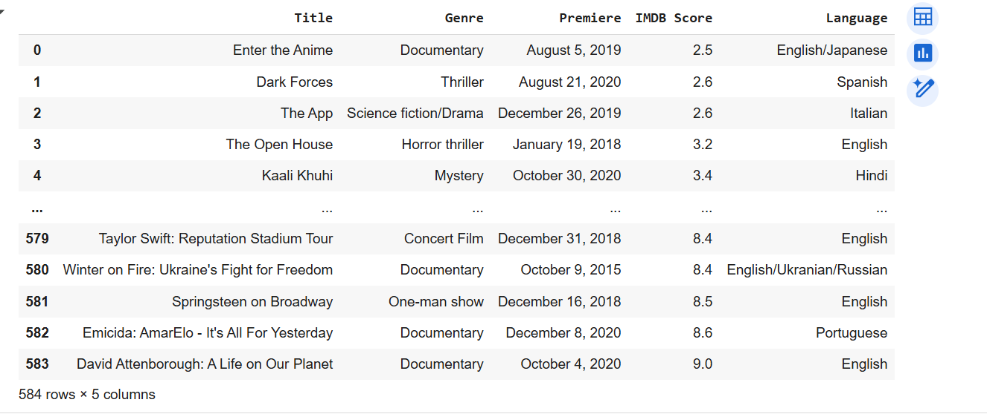
DataFrame
5

Slide 7
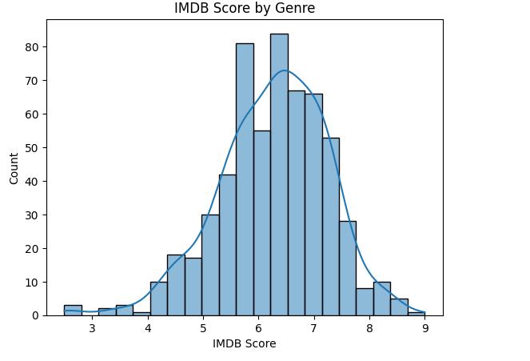
Histrogram Plot
6

Slide 8
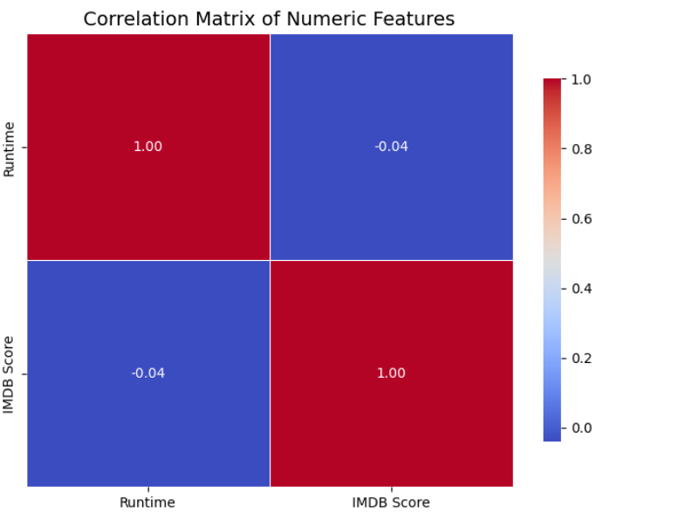
HeatMap
7

Slide 9




Feature Engineering
Rating Category
Standardized IMDB Scores by subtracting mean and dividing by standard deviation.
Created a new feature: Rating Category.
Benefits:
Scales data to mean 0, std 1.
Helps improve model accuracy.
Makes scores comparable across movies.
8

Slide 10

Key Findings
5-7
1
IMDB Scores
Dominant Language
Most films scored between 5 and 7.
English is the primary language.
2
Weak
Top Genres
Runtime Correlation
Documentary and Drama genres often have high IMDB scores.
Weak correlation between Runtime and IMDB Score.
9

Slide 11

Conclusion
Insights
Key Patterns
Identified helpful visual and statistical insights.
EDA Process
Cleaned data and explored significant patterns.
Summarized the entire Exploratory Data Analysis process.
10

Slide 12
Thank you

